Slide 1


Lecture 13: Data, Models, and Code
Addressing common issues
Harvard IACS
CS109A
Pavlos Protopapas, Kevin Rader, and Chris Tanner

Slide 2
ANNOUNCEMENTS
Homework 2 grades will be released soon
Homework 3 has been released. Due Oct 7 (Wed) @ 11:59pm
Standard Sections will be:
today at 1:30pm-2:45pm and
Monday 8:30pm-9:45pm
After lecture, please update your Zoom to the latest version (5.3.1)

Slide 3
Learning Objectives
Understand all concepts that are addressed in HW3, along with how they relate to one another
Be able to soundly prepare machine learning experiments, in terms of data splits and formatting
Know common strategies in debugging code
Feel prepared tackling the remaining course content / gain confidence!

Slide 4
Agenda
Review of Models
Review of Data
Debugging

Slide 5
Agenda
Review of Models
Review of Data
Debugging

Slide 6
What is the most difficult concept for you right now?

Slide 7
Your Data X
Given some data such that each row corresponds to a distinct i.i.d. observation
You may be interested in a particular column
Age
Play
Rainy
Temp
22
29
31
23
37
41
29
21
30
N
Y
N
Y
N
Y
Y
N
Y
Y
N
N
N
Y
N
Y
N
N
91
89
56
71
72
83
97
64
68

Slide 8
Your Data X
Given some data such that each row corresponds to a distinct i.i.d. observation
You may be interested in a particular column
Age
Play
Rainy
Temp
22
29
31
23
37
41
29
21
30
N
Y
N
Y
N
Y
Y
N
Y
Y
N
N
N
Y
N
Y
N
N
91
89
56
71
72
83
97
64
68

Slide 9
Your Data X
Given some data such that each row corresponds to a distinct i.i.d. observation
You may be interested in a particular column
Age
Play
Rainy
Temp
22
29
31
23
37
41
29
21
30
N
Y
N
Y
N
Y
Y
N
Y
Y
N
N
N
Y
N
Y
N
N
91
89
56
71
72
83
97
64
68

Slide 10
Your Data X
Given some data such that each row corresponds to a distinct i.i.d. observation
You may be interested in a particular column
Age
Play
Rainy
Temp
22
29
31
23
37
41
29
21
30
N
Y
N
Y
N
Y
Y
N
Y
Y
N
N
N
Y
N
Y
N
N
91
89
56
71
72
83
97
64
68

Slide 11
Your Data X
Given some data such that each row corresponds to a distinct i.i.d. observation
You may be interested in a particular column (e.g. Temp)
Age
Play
Rainy
Temp
22
29
31
23
37
41
29
21
30
N
Y
N
Y
N
Y
Y
N
Y
Y
N
N
N
Y
N
Y
N
N
91
89
56
71
72
83
97
64
68

Slide 12
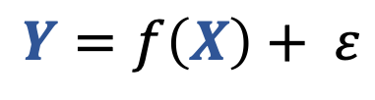
X
Y
Given some data such that each row corresponds to a distinct i.i.d. observation
You may be interested in a particular column (e.g. Temp)
Let’s divide our data and learn how data X is related to data Y
Assert that:
Age
Play
Rainy
Temp
22
29
31
23
37
41
29
21
30
N
Y
N
Y
N
Y
Y
N
Y
Y
N
N
N
Y
N
Y
N
N
91
89
56
71
72
83
97
64
68
$$Y=f\left(X\right)+ ε$$
Notes:
Y will represent our labelled data. Our gold truth.

Slide 13
X
Y
Given some data such that each row corresponds to a distinct i.i.d. observation
You may be interested in a particular column (e.g. Temp)
Let’s divide our data and learn how data X is related to data Y
Assert that:
Age
Play
Rainy
Temp
22
29
31
23
37
41
29
21
30
N
Y
N
Y
N
Y
Y
N
Y
Y
N
N
N
Y
N
Y
N
N
91
89
56
71
72
83
97
64
68
$$Y=f\left(X\right)+ ε$$

Slide 14
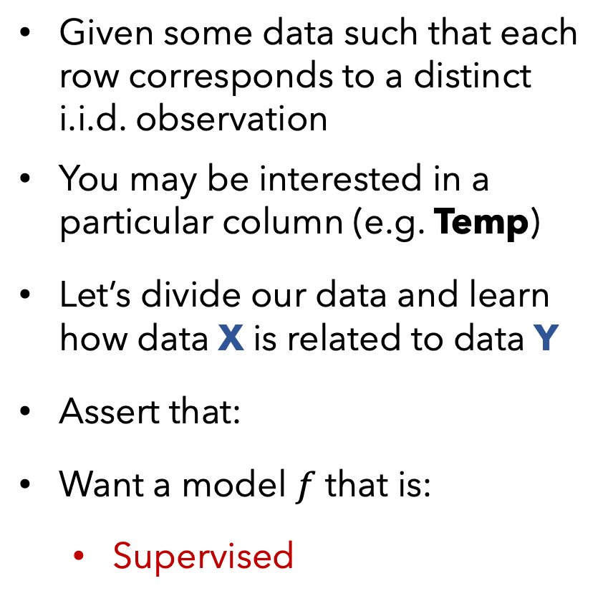
X
Y
Given some data such that each row corresponds to a distinct i.i.d. observation
You may be interested in a particular column (e.g. Temp)
Let’s divide our data and learn how data X is related to data Y
Assert that:
Want a model $f$ that is:
Supervised
Age
Play
Rainy
Temp
22
29
31
23
37
41
29
21
30
N
Y
N
Y
N
Y
Y
N
Y
Y
N
N
N
Y
N
Y
N
N
91
89
56
71
72
83
97
64
68
$$Y=f\left(X\right)+ ε$$

Slide 15

X
Y
Given some data such that each row corresponds to a distinct i.i.d. observation
You may be interested in a particular column (e.g. Temp)
Let’s divide our data and learn how data X is related to data Y
Assert that:
Want a model $f$that is:
Supervised
Age
Play
Rainy
Temp
22
29
31
23
37
41
29
21
30
N
Y
N
Y
N
Y
Y
N
Y
Y
N
N
N
Y
N
Y
N
N
91
89
56
71
72
83
97
64
68
$$Y=f\left(X\right)+ ε$$
Supervised

Slide 16

X
Y
Def:
Supervised models use target data, Y, to provide feedback so that your model can learn the relationship between X and Y.
Given some data such that each row corresponds to a distinct i.i.d. observation
You may be interested in a particular column (e.g. Temp)
Let’s divide our data and learn how data X is related to data Y
Assert that:
Want a model that is:
Supervised
Age
Play
Rainy
Temp
22
29
31
23
37
41
29
21
30
N
Y
N
Y
N
Y
Y
N
Y
Y
N
N
N
Y
N
Y
N
N
91
89
56
71
72
83
97
64
68
$$Y=f\left(X\right)+ ε$$
$$Ŷ=f\left(X\right)$$
Supervised

Slide 17
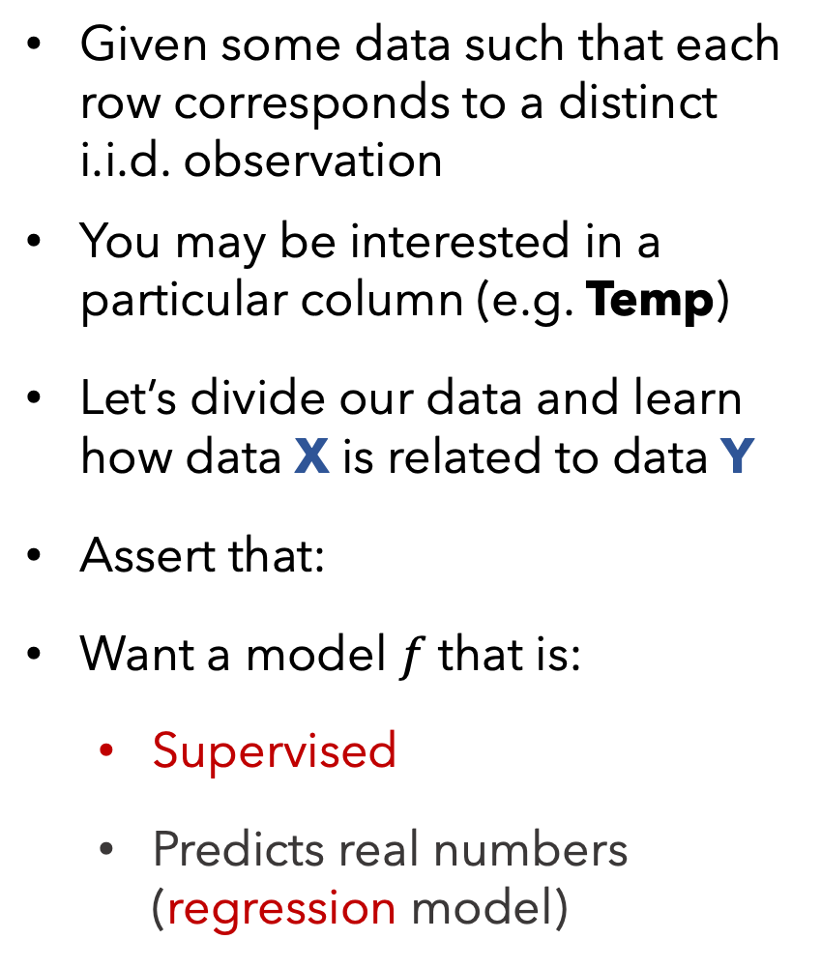
X
Y
Given some data such that each row corresponds to a distinct i.i.d. observation
You may be interested in a particular column (e.g. Temp)
Let’s divide our data and learn how data X is related to data Y
Assert that:
Want a model $f$that is:
Supervised
Predicts real numbers (regression model)
Age
Play
Rainy
Temp
22
29
31
23
37
41
29
21
30
N
Y
N
Y
N
Y
Y
N
Y
Y
N
N
N
Y
N
Y
N
N
91
89
56
71
72
83
97
64
68
$$Y=f\left(X\right)+ ε$$

Slide 18
X
Y
Given some data such that each row corresponds to a distinct i.i.d. observation
You may be interested in a particular column (e.g. Temp)
Let’s divide our data and learn how data X is related to data Y
Assert that:
Want a model that is:
Supervised
Predicts real numbers (regression model)
Age
Play
Rainy
Temp
Def:
Regression models are supervised models, whereby Y are continuous values.
22
29
31
23
37
41
29
21
30
N
Y
N
Y
N
Y
Y
N
Y
Y
N
N
N
Y
N
Y
N
N
91
89
56
71
72
83
97
64
68
$$Y=f\left(X\right)+ ε$$
regression model

Slide 19
X
Y
Given some data such that each row corresponds to a distinct i.i.d. observation
You may be interested in a particular column (e.g. Temp)
Let’s divide our data and learn how data X is related to data Y
Assert that:
Want a model that is:
Supervised
Predicts real numbers (regression model)
Age
Play
Rainy
Temp
Def:
Regression models are supervised models, whereby Y are continuous values.
Classification models are supervised models, whereby Y are categorical values.
22
29
31
23
37
41
29
21
30
N
Y
N
Y
N
Y
Y
N
Y
Y
N
N
N
Y
N
Y
N
N
91
89
56
71
72
83
97
64
68
$$Y=f\left(X\right)+ ε$$
regression model

Slide 20
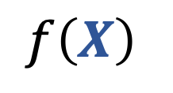
Linear Regression
Y
$$f\left(X\right)$$
X
High-level

Slide 21


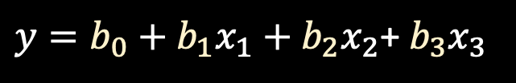


Linear Regression
Y
91
$$y$$
$$f\left(X\right)$$
$y=b_{0}+b_{1}x_{1}+b_{2}x_{2}$+ $b_{3}x_{3}$
22
N
Y
X
$$x_{1}$$
$$x_{2}$$
$$x_{3}$$
High-level
Mathematically

Slide 22
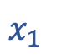
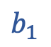
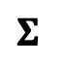

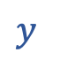
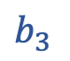
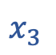
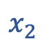
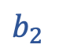
Linear Regression
Y
91
$$y$$
$$y$$
$$Σ$$
$$f\left(X\right)$$
$y=b_{0}+b_{1}x_{1}+b_{2}x_{2}$+ $b_{3}x_{3}$
$$b_{0}$$
$$b_{1}$$
$$b_{2}$$
$$b_{3}$$
22
N
Y
$$x_{1}$$
$$x_{2}$$
$$x_{3}$$
X
$$x_{1}$$
$$x_{2}$$
$$x_{3}$$
Graphically (NN format)
High-level
Mathematically

Slide 23
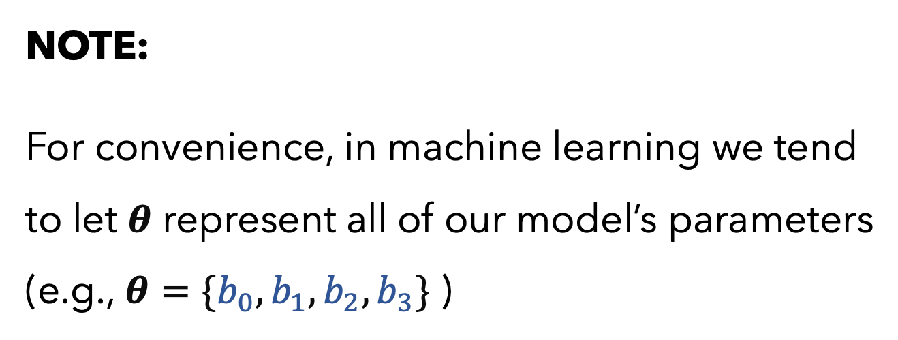
Linear Regression
Y
91
$$y$$
NOTE:
For convenience, in machine learning we tend to let $θ$ represent all of our model’s parameters (e.g., $θ=\{b_{0},b_{1},b_{2},b_{3}\}$ )
$$y$$
$$Σ$$
$$f\left(X\right)$$
$y=b_{0}+b_{1}x_{1}+b_{2}x_{2}$+ $b_{3}x_{3}$
$$b_{0}$$
$$b_{1}$$
$$b_{2}$$
$$b_{3}$$
22
N
Y
$$x_{1}$$
$$x_{2}$$
$$x_{3}$$
X
$$x_{1}$$
$$x_{2}$$
$$x_{3}$$
Graphically (NN format)
High-level
Mathematically

Slide 24
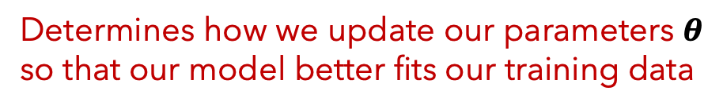
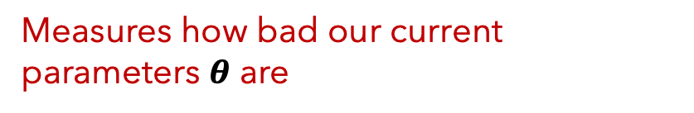
Supervised Models
IMPORTANT
When training any supervised model, be mindful of what you select for:
1. Our loss function (aka cost function)
Measures how bad our current parameters $θ$ are
2. Our optimization algorithm?
Determines how we update our parameters $θ$ so that our model better fits our training data

Slide 25
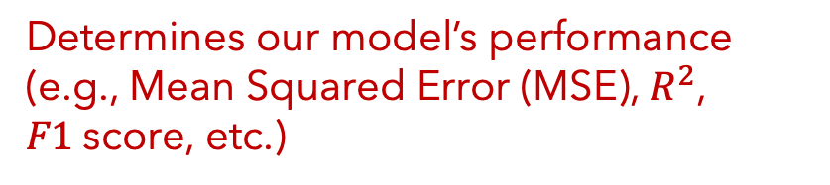
Supervised Models
IMPORTANT
When training any supervised model, be mindful of what you select for:
When testing our model’s predictions, be mindful of what you select for:
1. Our loss function (aka cost function)
3. Our evaluation metric
Measures how bad our current parameters $θ$ are
Determines our model’s performance (e.g., Mean Squared Error (MSE), $R^{2}$, $F1$score, etc.)
2. Our optimization algorithm?
Determines how we update our parameters $θ$ so that our model better fits our training data

Slide 26
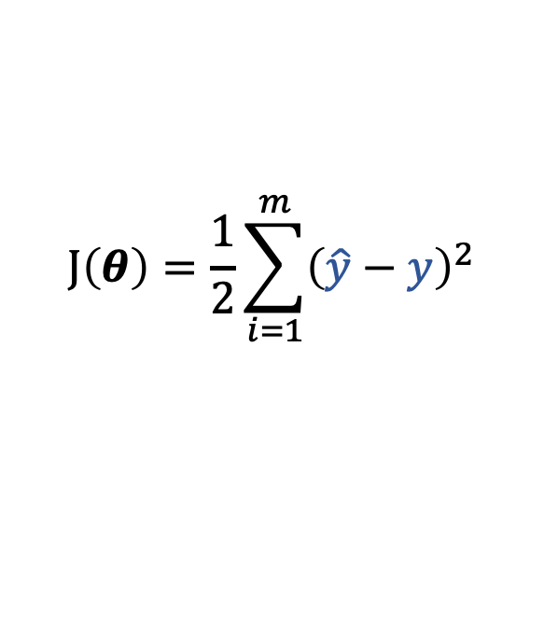


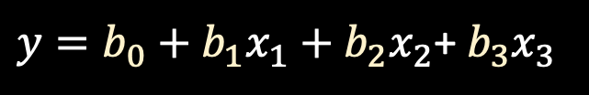


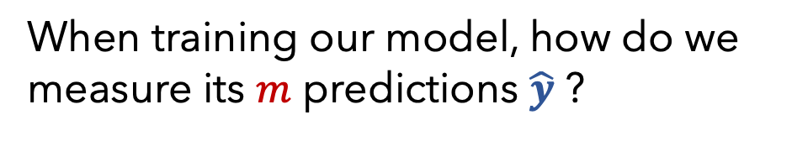
Linear Regression
Q1
When training our model, how do we measure its $m$ predictions $\hat{y}$ ?
91
$$y$$
$$J\left(θ\right)=\frac{1}{2}\sum_{i=1}^{m}{{\left(\hat{y}−y\right)}^{2}}$$
A1
Cost function
“Least Squares”
$y=b_{0}+b_{1}x_{1}+b_{2}x_{2}$+ $b_{3}x_{3}$
22
N
Y
$$x_{1}$$
$$x_{2}$$
$$x_{3}$$
Mathematically
Notes:
** ahead of time, we don’t know what the optimal theta parameters ought to be, we only know what the y values should be. So let’s just keep tweaking the parameters until we minimize the error of our predictions y-hat **

Slide 27
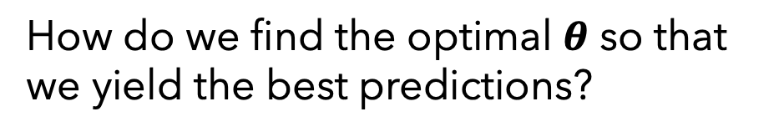
Linear Regression
Q1
When training our model, how do we measure its $m$ predictions $\hat{y}$ ?
91
$$y$$
$$J\left(θ\right)=\frac{1}{2}\sum_{i=1}^{m}{{\left(\hat{y}−y\right)}^{2}}$$
A1
Cost function
“Least Squares”
$y=b_{0}+b_{1}x_{1}+b_{2}x_{2}$+ $b_{3}x_{3}$
Q2
How do we find the optimal $θ$ so that we yield the best predictions?
22
N
Y
$$x_{1}$$
$$x_{2}$$
$$x_{3}$$
Mathematically

Slide 28

Linear Regression
Q1
When training our model, how do we measure its $m$ predictions $\hat{y}$ ?
91
$$y$$
$$J\left(θ\right)=\frac{1}{2}\sum_{i=1}^{m}{{\left(\hat{y}−y\right)}^{2}}$$
A1
Cost function
“Least Squares”
$y=b_{0}+b_{1}x_{1}+b_{2}x_{2}$+ $b_{3}x_{3}$
Q2
How do we find the optimal $θ$ so that we yield the best predictions?
A2
Two optimization algorithm options:
Gradient Descent (iteratively search)
Directly (closed-form solution)
22
N
Y
$$x_{1}$$
$$x_{2}$$
$$x_{3}$$
$$θ={\left(X^{T}X\right)}^{−1}X^{T}Y$$
Mathematically

Slide 29
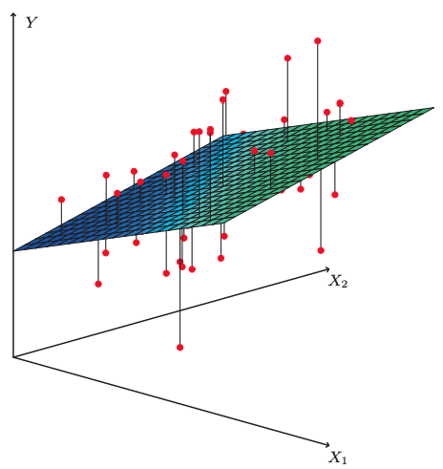
Linear Regression
Fitted model example
The plane is chosen to minimize the sum of the squared vertical distances (per our loss function, least squares) between each observation (red dots) and the plane.
Photo from ”An Introduction to Statistical Learning” (James, et al. 2017)

Slide 30
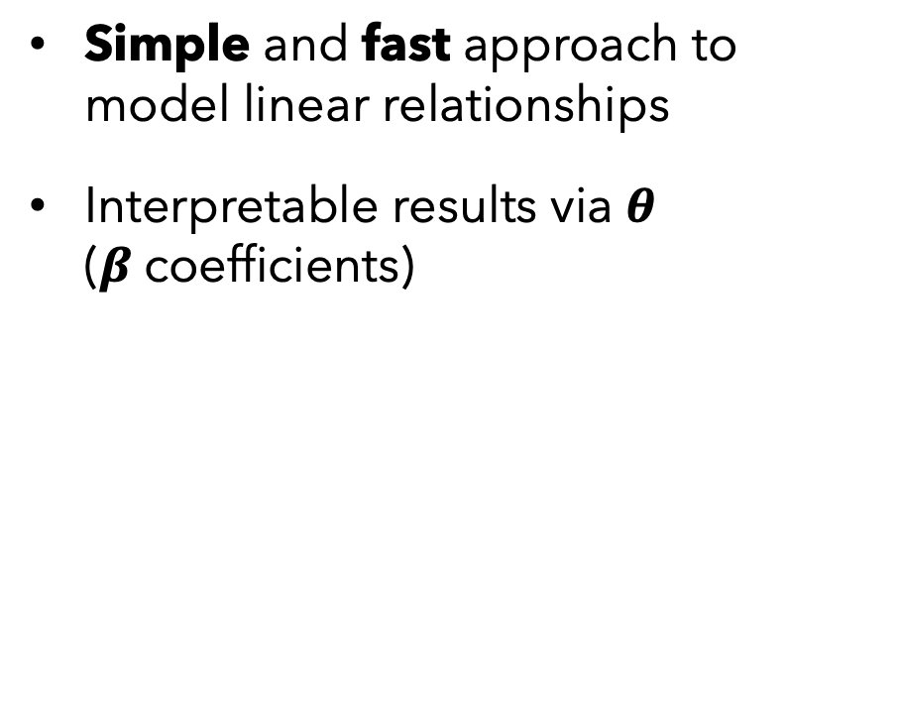
Linear Regression
PROS
CONS
Simple and fast approach to model linear relationships
Interpretable results via $θ$ ($β$coefficients)
Can’t model non-linear relationships
Vulnerable to outliers
Vulnerable to collinearity
Assumes error terms are uncorrelated*
* otherwise, we have false feedback during training

Slide 31
Supervised vs
Unsupervised
Regression vs Classification
Linear Regression
Supervised
Regression

Slide 32
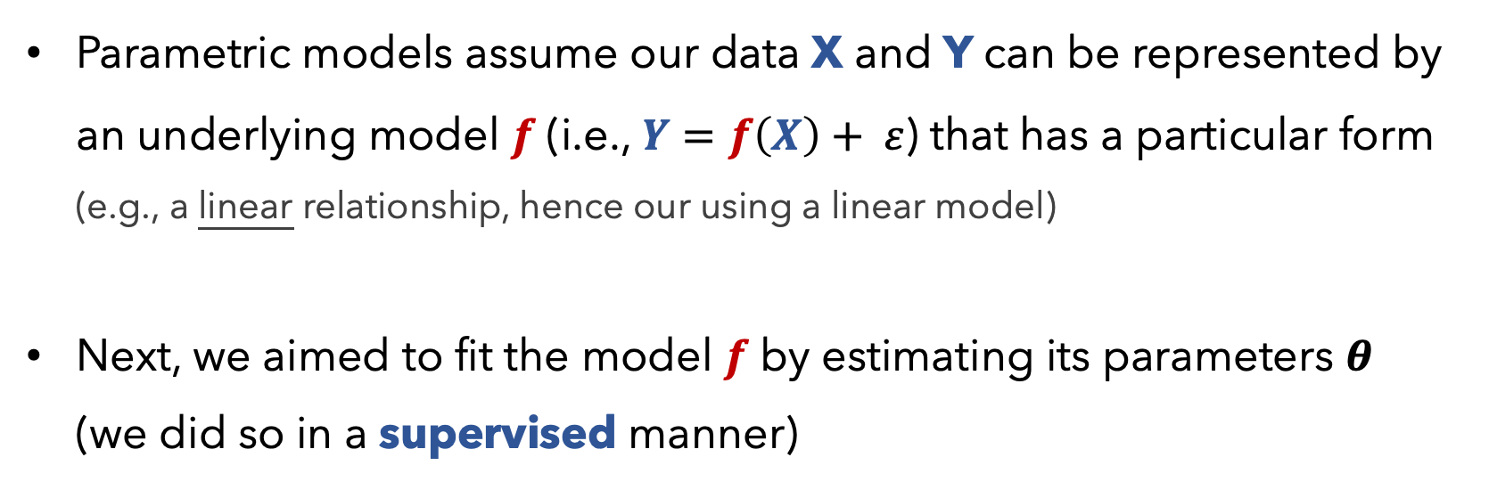
Parametric Models
Parametric models assume our data X and Y can be represented by an underlying model $f$ (i.e., $Y=f\left(X\right)+ ε$) that has a particular form (e.g., a linear relationship, hence our using a linear model)
Next, we aimed to fit the model $f$ by estimating its parameters $θ$ (we did so in a supervised manner)

Slide 33
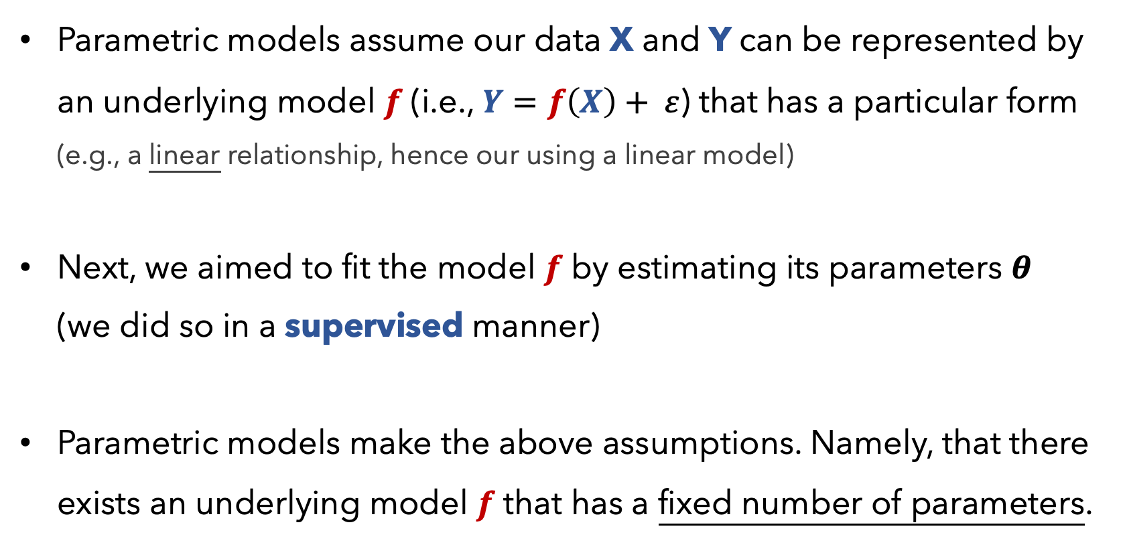
Parametric Models
Parametric models assume our data X and Y can be represented by an underlying model $f$ (i.e., $Y=f\left(X\right)+ ε$) that has a particular form (e.g., a linear relationship, hence our using a linear model)
Next, we aimed to fit the model $f$ by estimating its parameters $θ$ (we did so in a supervised manner)
Parametric models make the above assumptions. Namely, that there exists an underlying model $f$ that has a fixed number of parameters.

Slide 34
Supervised vs
Unsupervised
Regression vs Classification
Parametric vs
Non-Parametric
Linear Regression
Supervised
Regression
Parametric

Slide 35
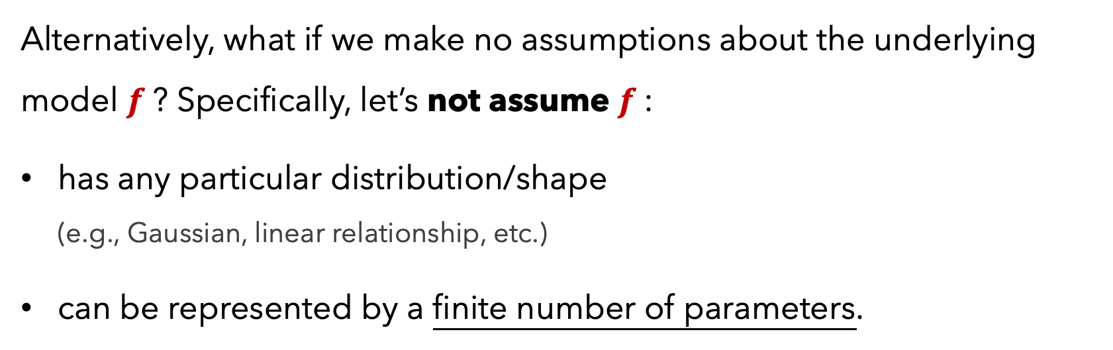
Non-Parametric Models
Alternatively, what if we make no assumptions about the underlying model $f$? Specifically, let’s not assume $f$:
has any particular distribution/shape (e.g., Gaussian, linear relationship, etc.)
can be represented by a finite number of parameters.

Slide 36
Non-Parametric Models
Alternatively, what if we make no assumptions about the underlying model $f$? Specifically, let’s not assume $f$:
has any particular distribution/shape (e.g., Gaussian, linear relationship, etc.)
can be represented by a finite number of parameters.
This would constitute a non-parametric model.

Slide 37
Non-Parametric Models
Non-parametric models are allowed to have parameters; in fact, oftentimes the # of parameters grows as our amount of training data increases
Since they make no strong assumptions about the form of the function/model, they are free to learn any functional form from the training data -- infinitely complex.

Slide 38
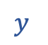
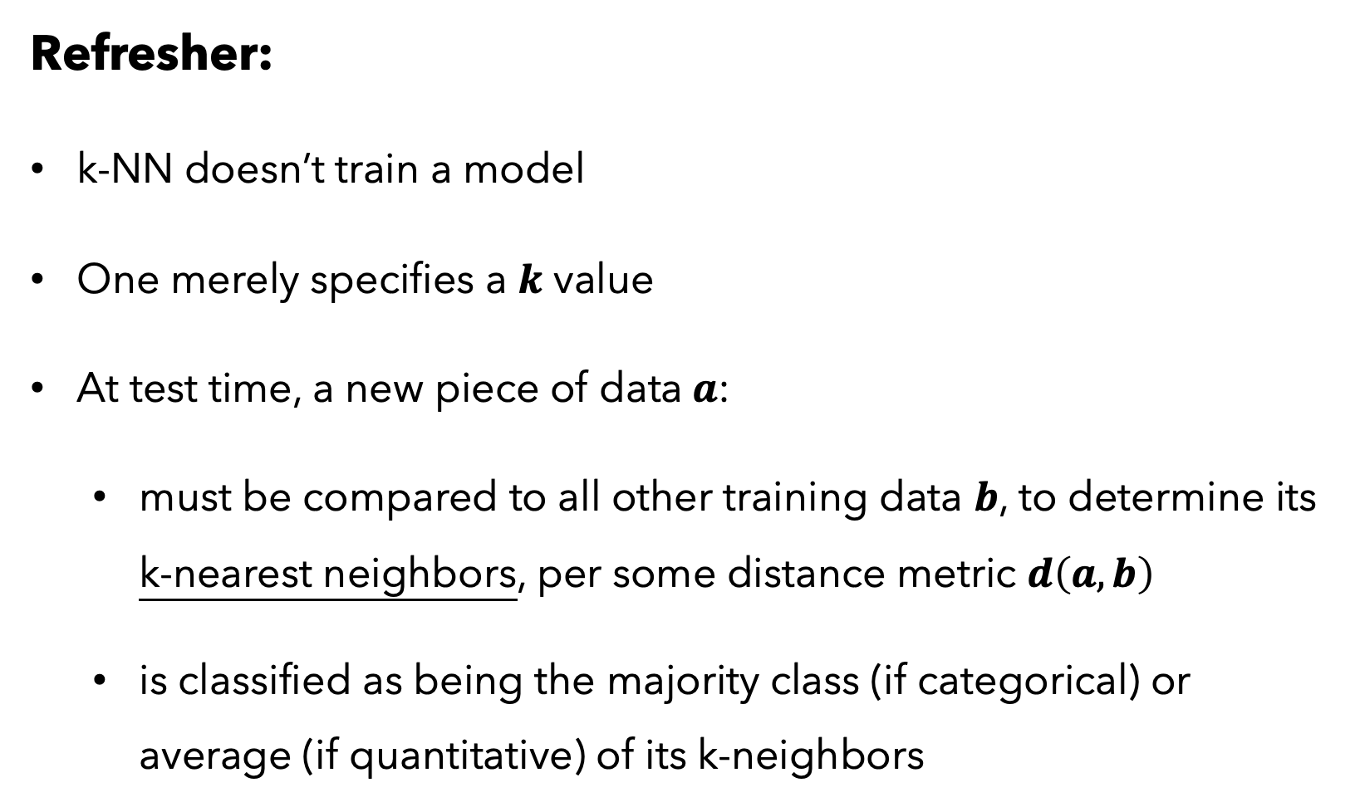




k-NN
Refresher:
k-NN doesn’t train a model
One merely specifies a $k$ value
At test time, a new piece of data $a$:
must be compared to all other training data $b$, to determine its k-nearest neighbors, per some distance metric $d\left(a,b\right)$
is classified as being the majority class (if categorical) or average (if quantitative) of its k-neighbors
N
$$y$$
$$y=σ(βX)$$
22
91
Y
$$x_{1}$$
$$x_{2}$$
$$x_{3}$$
Mathematically

Slide 39

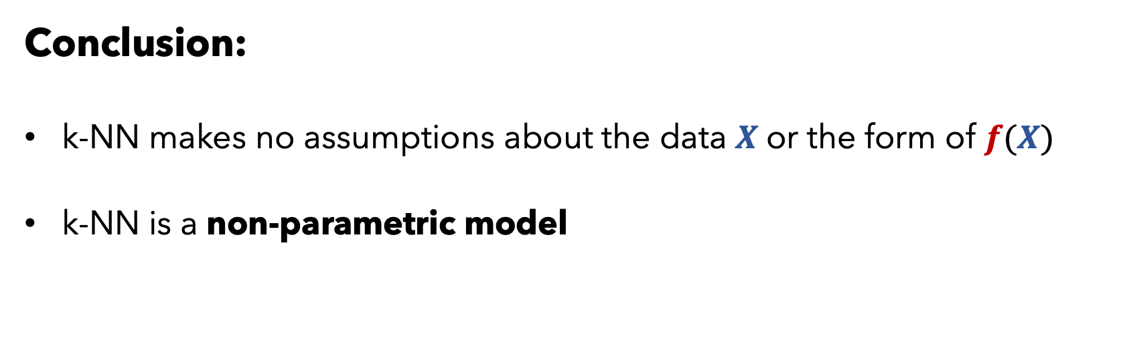
k-NN
Conclusion:
k-NN makes no assumptions about the data $X$or the form of $f(X)$
k-NN is a non-parametric model

Slide 40
k-NN
PROS
CONS
Intuitive and simple approach
Can model any type of data / places no assumptions on the data
Fairly robust to missing data
Good for highly sparse data (e.g., user data, where the columns are thousands of potential items of interest)
Can be very computationally expensive if the data is large or high-dimensional
Should carefully think about features, including scaling them
Mixing quantitative and categorical data can be tricky
Interpretation isn’t meaningful
Often, regression models are better, especially with little data

Slide 41
Supervised vs
Unsupervised
Regression vs Classification
Parametric vs
Non-Parametric
Linear Regression
k-NN
Supervised
Regression
Parametric
Supervised
either
Non-Parametric

Slide 42
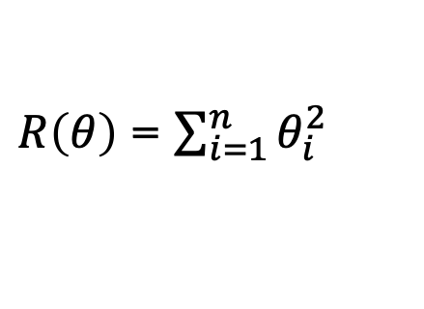
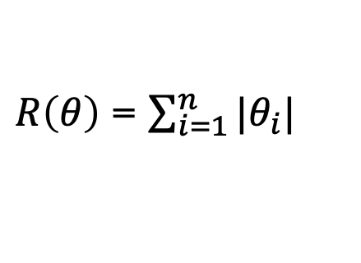
Supervised Models
IMPORTANT
When training any supervised model, be careful of overfitting your model
A good model should generalize well to unseen (i.e., testing) data
Consider adding regularization term $R\left(θ\right)$ to your cost function
Imposes a penalty based on your parameter values $θ$
L1 regularization:
$R\left(θ\right)$ = $\sum_{i=1}^{n}{|θ_{i}|}$
Prefers sparse weights (many 0’s)
L2 regularization:
$R\left(θ\right)$ = $\sum_{i=1}^{n}{θ_{i}^{2}}$
Prefers many small-weight values

Slide 43
Supervised Models
IMPORTANT
When training any supervised model, wisely use your training data
A good model should generalize well to unseen (i.e., testing) data
Shuffle your training data and optionally bootstrap samples
Perform cross-validation

Slide 44
Q1. Say our dataset has just 4 features (each row corresponds to a distinct day):
Day of the week, where each value is one of {”M”, “T”, “W”, “Th”, “F”, “Sa”, “Su”}
Average temperature outside today (range is from 21F to 102F)
Average weather today, where each value is one of {“Sunny”, “Cloudy”, “Rainy”, “Overcast”, “Snowy”}
# of people who paid to rent/ride a public city bike (i.e., Boston’s BlueBike) for at least 10 minutes on the given day
We are interested in predicting the last feature by using the previous three. How would you go about modelling this? Data and modelling choices? Discuss w/ your group.

Slide 45
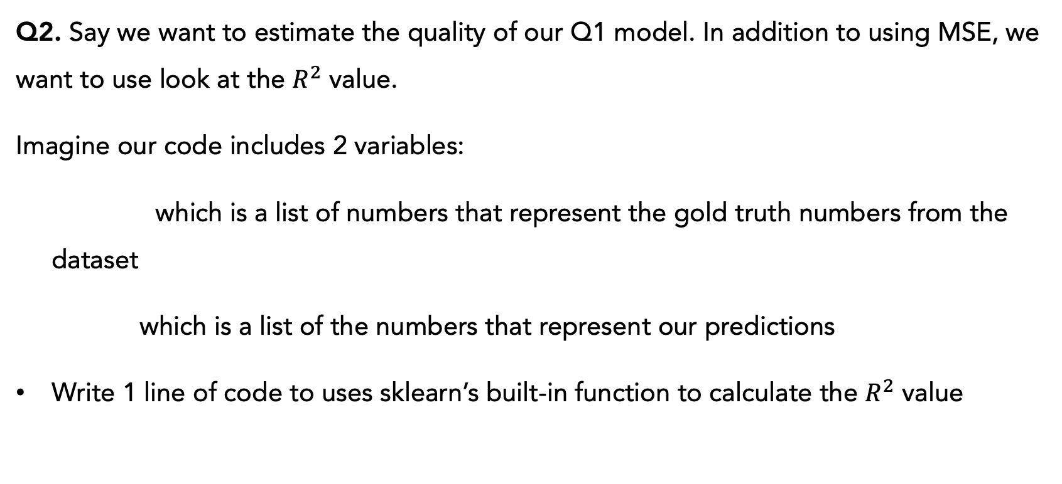
Q2. Say we want to estimate the quality of our Q1 model. In addition to using MSE, we want to use look at the $R^{2}$ value.
Imagine our code includes 2 variables:
target_y which is a list of numbers that represent the gold truth numbers from the dataset
pred_y which is a list of the numbers that represent our predictions
Write 1 line of code to uses sklearn’s built-in function to calculate the $R^{2}$ value

Slide 46
Break-out room time! (Discussion, no coding)

Slide 47
Agenda
Review of Models
Review of Data
Debugging

Slide 48
Agenda
Review of Models
Review of Data
Debugging

Slide 49
Your Data X
Age
Play
Rainy
Temp
Let’s say our data has 1,000 rows
22
29
31
23
37
41
29
21
30
45
21
19
44
36
13
22
28
35
52
17
N
Y
N
Y
N
Y
Y
N
Y
N
N
N
Y
Y
Y
N
Y
N
Y
Y
Y
N
N
N
Y
N
Y
N
N
N
Y
Y
Y
N
Y
Y
N
N
Y
Y
91
89
56
71
72
83
97
64
68
61
56
36
53
80
83
68
71
55
92
78
1,000

Slide 50
Your Data X
Let’s say our data has 1,000 rows
And that we want to predict Temp
Age
Play
Rainy
Temp
22
29
31
23
37
41
29
21
30
45
21
19
44
36
13
22
28
35
52
17
N
Y
N
Y
N
Y
Y
N
Y
N
N
N
Y
Y
Y
N
Y
N
Y
Y
Y
N
N
N
Y
N
Y
N
N
N
Y
Y
Y
N
Y
Y
N
N
Y
Y
91
89
56
71
72
83
97
64
68
61
56
36
53
80
83
68
71
55
92
78
1,000

Slide 51
X
Y
Let’s say our data has 1,000 rows
And that we want to predict Temp
Age
Play
Rainy
Temp
22
29
31
23
37
41
29
21
30
45
21
19
44
36
13
22
28
35
52
17
N
Y
N
Y
N
Y
Y
N
Y
N
N
N
Y
Y
Y
N
Y
N
Y
Y
Y
N
N
N
Y
N
Y
N
N
N
Y
Y
Y
N
Y
Y
N
N
Y
Y
91
89
56
71
72
83
97
64
68
61
56
36
53
80
83
68
71
55
92
78
1,000

Slide 52
X
Y
Let’s say our data has 1,000 rows
And that we want to predict Temp
Which data should we use? All of it?
Age
Play
Rainy
Temp
22
29
31
23
37
41
29
21
30
45
21
19
44
36
13
22
28
35
52
17
N
Y
N
Y
N
Y
Y
N
Y
N
N
N
Y
Y
Y
N
Y
N
Y
Y
Y
N
N
N
Y
N
Y
N
N
N
Y
Y
Y
N
Y
Y
N
N
Y
Y
91
89
56
71
72
83
97
64
68
61
56
36
53
80
83
68
71
55
92
78
TRAINING

Slide 53
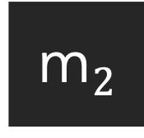
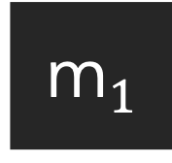
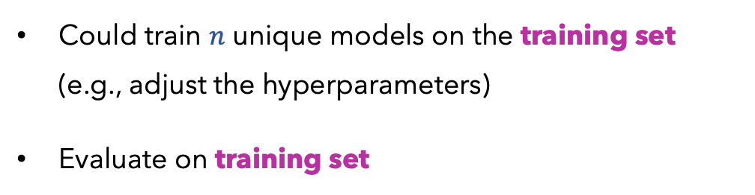

X
Y
Let’s say our data has 1,000 rows
And that we want to predict Temp
Which data should we use? All of it?
Age
Play
Rainy
Temp
22
29
31
23
37
41
29
21
30
45
21
19
44
36
13
22
28
35
52
17
N
Y
N
Y
N
Y
Y
N
Y
N
N
N
Y
Y
Y
N
Y
N
Y
Y
Y
N
N
N
Y
N
Y
N
N
N
Y
Y
Y
N
Y
Y
N
N
Y
Y
91
89
56
71
72
83
97
64
68
61
56
36
53
80
83
68
71
55
92
78
…
TRAINING
m$1$
m$2$
m$N$
Could train $n$ unique models on the training set (e.g., adjust the hyperparameters)
Evaluate on training set

Slide 54
X
Y
Let’s say our data has 1,000 rows
And that we want to predict Temp
Which data should we use? All of it?
Models always have a risk of just memorizing/overfitting on the training data
Many will likely yield 100% accuracy
We need some indication as to how well we’ll do on unseen, future data
Age
Play
Rainy
Temp
22
29
31
23
37
41
29
21
30
45
21
19
44
36
13
22
28
35
52
17
N
Y
N
Y
N
Y
Y
N
Y
N
N
N
Y
Y
Y
N
Y
N
Y
Y
Y
N
N
N
Y
N
Y
N
N
N
Y
Y
Y
N
Y
Y
N
N
Y
Y
91
89
56
71
72
83
97
64
68
61
56
36
53
80
83
68
71
55
92
78
TRAINING

Slide 55
X
Y
Let’s say our data has 1,000 rows
And that we want to predict Temp
Which data should we use? Split it in two?
Age
Play
Rainy
Temp
22
29
31
23
37
41
29
21
30
45
21
19
44
36
13
22
28
35
52
17
N
Y
N
Y
N
Y
Y
N
Y
N
N
N
Y
Y
Y
N
Y
N
Y
Y
Y
N
N
N
Y
N
Y
N
N
N
Y
Y
Y
N
Y
Y
N
N
Y
Y
91
89
56
71
72
83
97
64
68
61
56
36
53
80
83
68
71
55
92
78
TRAINING
TESTING

Slide 56
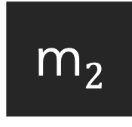

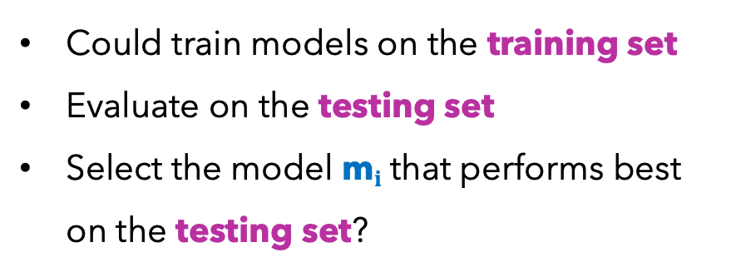

X
Y
Let’s say our data has 1,000 rows
And that we want to predict Temp
Which data should we use? Split it in two?
Age
Play
Rainy
Temp
22
29
31
23
37
41
29
21
30
45
21
19
44
36
13
22
28
35
52
17
N
Y
N
Y
N
Y
Y
N
Y
N
N
N
Y
Y
Y
N
Y
N
Y
Y
Y
N
N
N
Y
N
Y
N
N
N
Y
Y
Y
N
Y
Y
N
N
Y
Y
91
89
56
71
72
83
97
64
68
61
56
36
53
80
83
68
71
55
92
78
TRAINING
m$1$
m$2$
…
m$N$
Could train models on the training set
Evaluate on the testing set
Select the model m$i$ that performs best on the testing set?
TESTING

Slide 57
X
Y
Let’s say our data has 1,000 rows
And that we want to predict Temp
Which data should we use? Split it in two?
Age
Play
Rainy
Temp
22
29
31
23
37
41
29
21
30
45
21
19
44
36
13
22
28
35
52
17
N
Y
N
Y
N
Y
Y
N
Y
N
N
N
Y
Y
Y
N
Y
N
Y
Y
Y
N
N
N
Y
N
Y
N
N
N
Y
Y
Y
N
Y
Y
N
N
Y
Y
91
89
56
71
72
83
97
64
68
61
56
36
53
80
83
68
71
55
92
78
TRAINING
Selecting our model based on its performance on the testing set could yield unrealistic expectations and it’s like cheating, if such performance mattered (e.g., developing new models); it’s like gaming the system
TESTING

Slide 58
X
Y
Let’s say our data has 1,000 rows
And that we want to predict Temp
Which data should we use? Split it into three?
Age
Play
Rainy
Temp
22
29
31
23
37
41
29
21
30
45
21
19
44
36
13
22
28
35
52
17
N
Y
N
Y
N
Y
Y
N
Y
N
N
N
Y
Y
Y
N
Y
N
Y
Y
Y
N
N
N
Y
N
Y
N
N
N
Y
Y
Y
N
Y
Y
N
N
Y
Y
91
89
56
71
72
83
97
64
68
61
56
36
53
80
83
68
71
55
92
78
TRAINING
DEV
TESTING

Slide 59
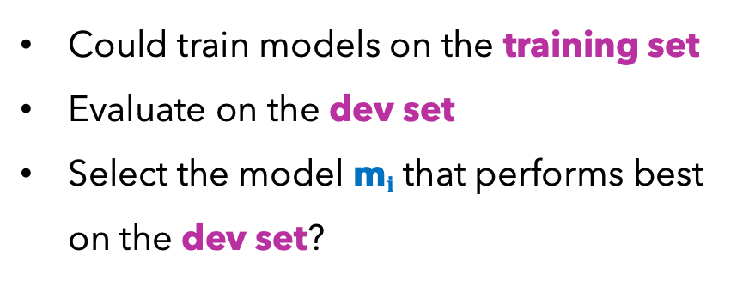
X
Y
Let’s say our data has 1,000 rows
And that we want to predict Temp
Which data should we use? Split it into three?
Age
Play
Rainy
Temp
22
29
31
23
37
41
29
21
30
45
21
19
44
36
13
22
28
35
52
17
N
Y
N
Y
N
Y
Y
N
Y
N
N
N
Y
Y
Y
N
Y
N
Y
Y
Y
N
N
N
Y
N
Y
N
N
N
Y
Y
Y
N
Y
Y
N
N
Y
Y
91
89
56
71
72
83
97
64
68
61
56
36
53
80
83
68
71
55
92
78
TRAINING
m$1$
m$2$
…
m$N$
DEV
Could train models on the training set
Evaluate on the dev set
Select the model m$i$ that performs best on the dev set?
TESTING

Slide 60
X
Y
Let’s say our data has 1,000 rows
And that we want to predict Temp
Which data should we use? Split it into three?
Age
Play
Rainy
Temp
22
29
31
23
37
41
29
21
30
45
21
19
44
36
13
22
28
35
52
17
N
Y
N
Y
N
Y
Y
N
Y
N
N
N
Y
Y
Y
N
Y
N
Y
Y
Y
N
N
N
Y
N
Y
N
N
N
Y
Y
Y
N
Y
Y
N
N
Y
Y
91
89
56
71
72
83
97
64
68
61
56
36
53
80
83
68
71
55
92
78
TRAINING
m$1$
m$2$
…
m$N$
DEV
Could train models on the training set
Evaluate on the dev set
Select the model m$i$ that performs best on the dev set?
TESTING

Slide 61
X
Y
Let’s say our data has 1,000 rows
And that we want to predict Temp
Which data should we use? Split it into three?
Age
Play
Rainy
Temp
22
29
31
23
37
41
29
21
30
45
21
19
44
36
13
22
28
35
52
17
N
Y
N
Y
N
Y
Y
N
Y
N
N
N
Y
Y
Y
N
Y
N
Y
Y
Y
N
N
N
Y
N
Y
N
N
N
Y
Y
Y
N
Y
Y
N
N
Y
Y
91
89
56
71
72
83
97
64
68
61
56
36
53
80
83
68
71
55
92
78
TRAINING
Perfect! This allows us to tweak our models and optimize for the dev set, with no cheating, for we truly ignore the test set until we want a fair, final, one-time evaluation of our best model. It’s like blindfolding ourselves so we have a fair impression of the goodness of our model.
DEV
TESTING

Slide 62
X
Y
Let’s say our data has 1,000 rows
And that we want to predict Temp
Which data should we use? Split it into three?
Age
Play
Rainy
Temp
22
29
31
23
37
41
29
21
30
45
21
19
44
36
13
22
28
35
52
17
N
Y
N
Y
N
Y
Y
N
Y
N
N
N
Y
Y
Y
N
Y
N
Y
Y
Y
N
N
N
Y
N
Y
N
N
N
Y
Y
Y
N
Y
Y
N
N
Y
Y
91
89
56
71
72
83
97
64
68
61
56
36
53
80
83
68
71
55
92
78
TRAINING
This allows us to fairly evaluate our model.
Moreover, if we develop novel models, we can fairly compare against others’ systems that run on the same data.
DEV
TESTING

Slide 63
The more data we have, the better
We should always use these splits
Training is typically ~70% of your entire data
While this approach is sound, the dev set is often fairly small. Gives limited view into performance expectations. Cross-validation to the rescue!
Popular datasets often come with these 3 splits already designated
X
Y
Age
Play
Rainy
Temp
22
29
31
23
37
41
29
21
30
45
21
19
44
36
13
22
28
35
52
17
N
Y
N
Y
N
Y
Y
N
Y
N
N
N
Y
Y
Y
N
Y
N
Y
Y
Y
N
N
N
Y
N
Y
N
N
N
Y
Y
Y
N
Y
Y
N
N
Y
Y
91
89
56
71
72
83
97
64
68
61
56
36
53
80
83
68
71
55
92
78
TRAINING
DEV
TESTING

Slide 64
ZOOM OUT
A machine learning model aims to use data to perform a particular task well. Often, the task is to predict or classify new data.
CHOMBOSAN / ALAMY STOCK PHOTO
Self-driving cars
Voice assistants
Face recognition

Slide 65
ZOOM OUT
If models for the following tasks only used a training set, no dev set or test, then all systems would be horrible!
CHOMBOSAN / ALAMY STOCK PHOTO
Self-driving cars
Voice assistants
Face recognition
Woops, never seen this road before. CRASH!
“Sorry, I’ve never heard words pronounced like this before.”
Never seen your face before. Phone locked.

Slide 66
ANOTHER ANALOGY
When thinking of dataset splits, I like to think about a real student as our machine learning model.

Slide 67
ANOTHER ANALOGY
When thinking of dataset splits, I like to think about a real student as our machine learning model.
Say María is taking organic chemistry.
Her task is to learn the material, and her evaluation of such will be her final exam.

Slide 68
ANOTHER ANALOGY
María’s training data is all of the course homework problems.
It prepares her. It’s how she learns.
That data is her best indication of what’s to come for the real-deal final exam (i.e., testing set).

Slide 69
ANOTHER ANALOGY
If she simply memorized (i.e., overfit to) her homework problems over the semester, she would likely be able to achieve 100% on those exact problems (the training set).
But, this gives no indication as to how she’ll fare on the final exam (the testing set).
We always assume the testing set is from the same distribution that generated the training data. If it’s identical to the training (homework), though, that would be bizarre, trivial, and lame.

Slide 70
ANOTHER ANALOGY
X
Y
Problem₁
Problem₂
Problem₃
.
.
.
Problem₄₀₀
ans₁
ans₂
ans₃
.
.
.
ans₄₀₀
It would be way better if she learned the homework (training), then used the held-out problems (dev set) to fine-tune her learning.
This would help her learn best for the unseen problems that are to come! (test set)
TRAINING
Problem₄₀₁
Problem₄₀₂
.
.
Problem₄₅₀
ans₄₀₁
ans₄₀₂
.
.
.
ans₄₅₀
DEV
Problem₄₅₁
Problem₄₅₂
.
Problem₅₀₀
ans₄₅₁
ans₄₅₂
.
.
.
ans₅₀₀
TESTING

Slide 71
Agenda
Review of Models
Review of Data
Debugging

Slide 72
Agenda
Review of Models
Review of Data
Debugging

Slide 73
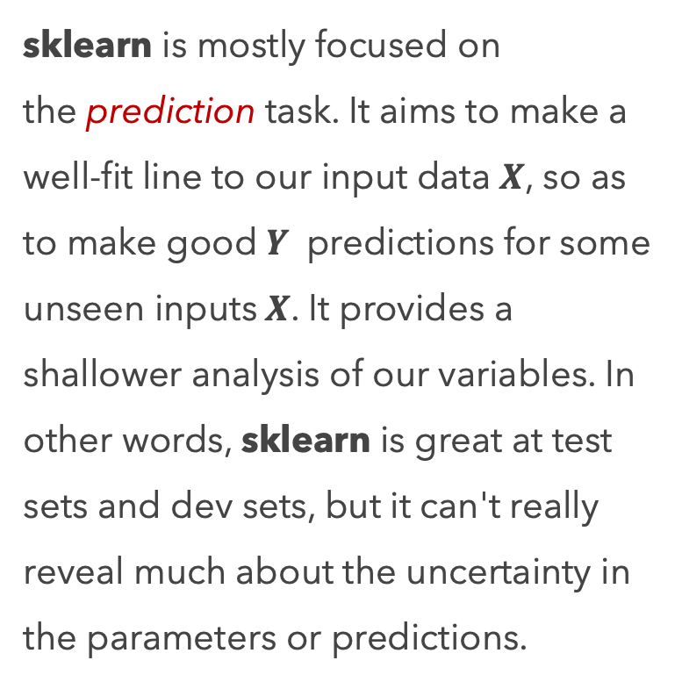
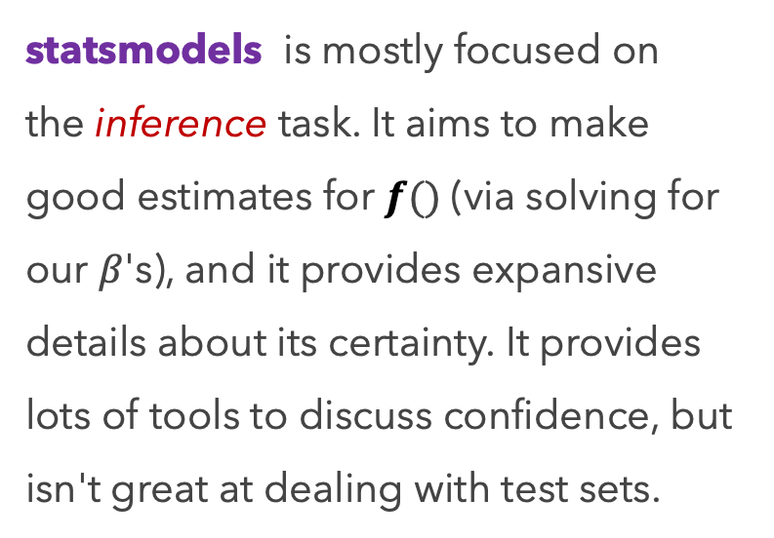
Programming
We have recently used two highly popular, useful libraries, statsmodels and sklearn.
statsmodels is mostly focused on the inference task. It aims to make good estimates for $f()$ (via solving for our $β$'s), and it provides expansive details about its certainty. It provides lots of tools to discuss confidence, but isn't great at dealing with test sets.
sklearn is mostly focused on the prediction task. It aims to make a well-fit line to our input data $X$, so as to make good $Y$ predictions for some unseen inputs $X$. It provides a shallower analysis of our variables. In other words, sklearn is great at test sets and dev sets, but it can't really reveal much about the uncertainty in the parameters or predictions.

Slide 74
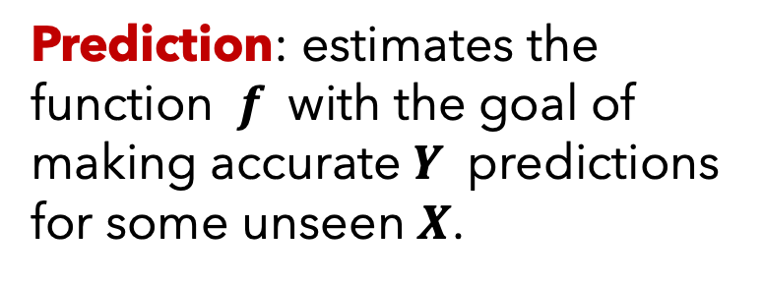
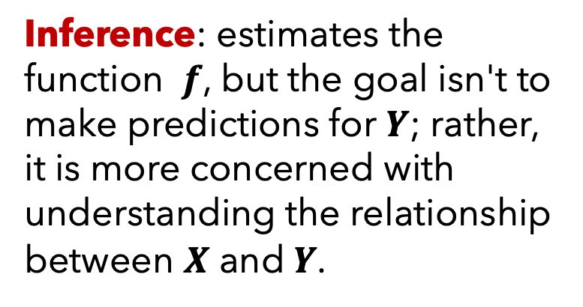
Programming
REMINDER
Inference: estimates the function $f$, but the goal isn't to make predictions for $Y$; rather, it is more concerned with understanding the relationship between $X$ and $Y$.
Prediction: estimates the function $f$ with the goal of making accurate $Y$ predictions for some unseen $X$.

Slide 75
Programming
Programming takes practice. No way around it. Practice, practice, practice.
We teach the fundamentals of data science and machine learning. Library packages, by themselves, are not fundamentals; they are accessible, high-level tools to accomplish certain tasks. They also change from time-to-time. Thus, it would be horrible if the course’s main focus was on functions provided by pandas, NumPy, scikits-learn, etc.
Via examples, we aim to show the benefits and power of them.
They are incredibly powerful tools, and we make heavy usage of them, but we rely on you to explore how to make them work for you.

Slide 76
Debugging
Debugging is a large topic, and yet it’s only a small aspect of the larger field of software testing
Here are some of my tips:

Slide 77
Debugging
Pay close attention to the error message (read the output)
When coding, start simple! Stop trying to do too much at once.
print() things out. Often. Check the type, size, and contents of the data structure at hand.
Be suspicious and doubtful of everything you type. The default is for things to not work. By default, your code will not work.

Slide 78
Debugging
Pay attention to scope and leaky variables
In Jupyter Notebooks, pay careful attention to the order in which you run cells
Writing on paper to draft ideas and debug can be highly useful.
Get a proper debugger (e.g., with Visual Studio code editor).

Slide 79
Debugging
Everything can be distilled down to data structures and algorithms..
Code can have:
Correct logic, but incorrect implementation
Incorrect logic, but correct implementation of your bad logic
Incorrect logic, and incorrect implementation
Correct logic, correct implementation.
If there’s an error, it’s either in your logic or implementation, or both

Slide 80
Exercise time!

